Slide 1
Capstone Project Presentation
Student Name - Niketana K P
Project Guide - Mr. Javeed Mohammed Husnuddin
Project Name - Hexaware Asset Management System
Date of Submission - 13/09/2025

Slide 2
Technologies & Tools Used
1. Backend
Java: Core programming language
Spring Boot: Main framework to build RESTful web services
3. Database
MySQL: Database Management System for storing and managing application data
2. Frontend
React.js: UI framework
Bootstrap: For styling and responsive design
4. Authentication
JSON Web Tokens (JWT): For secure authentication and authorization

Slide 3
Project Introduction
Problem Statement : Hexaware currently uses a variety of systems to handle and keep track of various kinds of assets. However, we are developing our application to lessen the inconvenience and difficulties brought on by the lack of a single platform to track all the assets. All of the company's assets that an employee has borrowed will be tracked by the application on a single platform. It aids the business in enhancing the system for tracking and recording the assets connected to each employee, enhancing the current system's accuracy and accountability.

Slide 4
Scope of the Project
Employee Registration and Authentication: Allow users to register, log in, and securely manage their accounts.
Asset catalogue: Display a wide range of Asset with detailed information, including images, descriptions, and asset status.
Asset Borrowing and Return: Enable employee to request for new asset and return the tagged asset
Asset Service: Enable the employee to raise service request and admin can update the service request.
Asset Audit and report: Admin can send the audit request employee and employee can audit the asset.

Slide 5
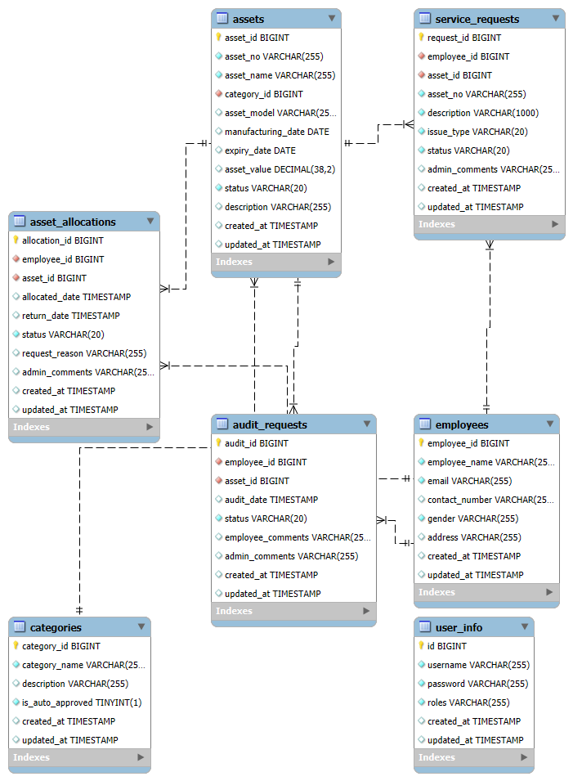
Entity-Relationship Diagram

Slide 6
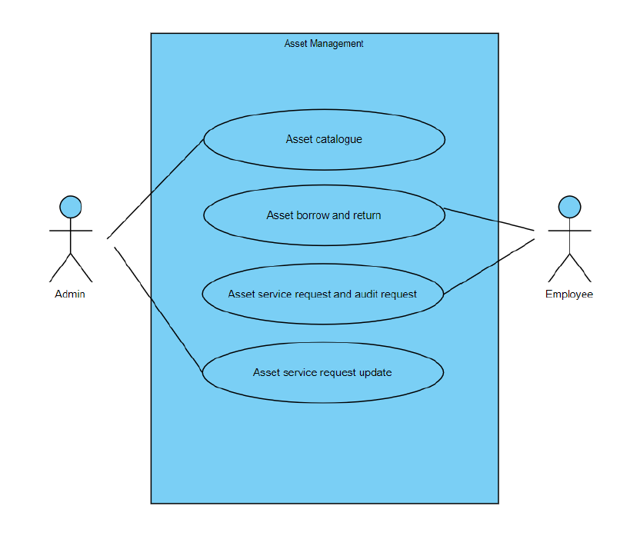
Use Case Diagram

Slide 7
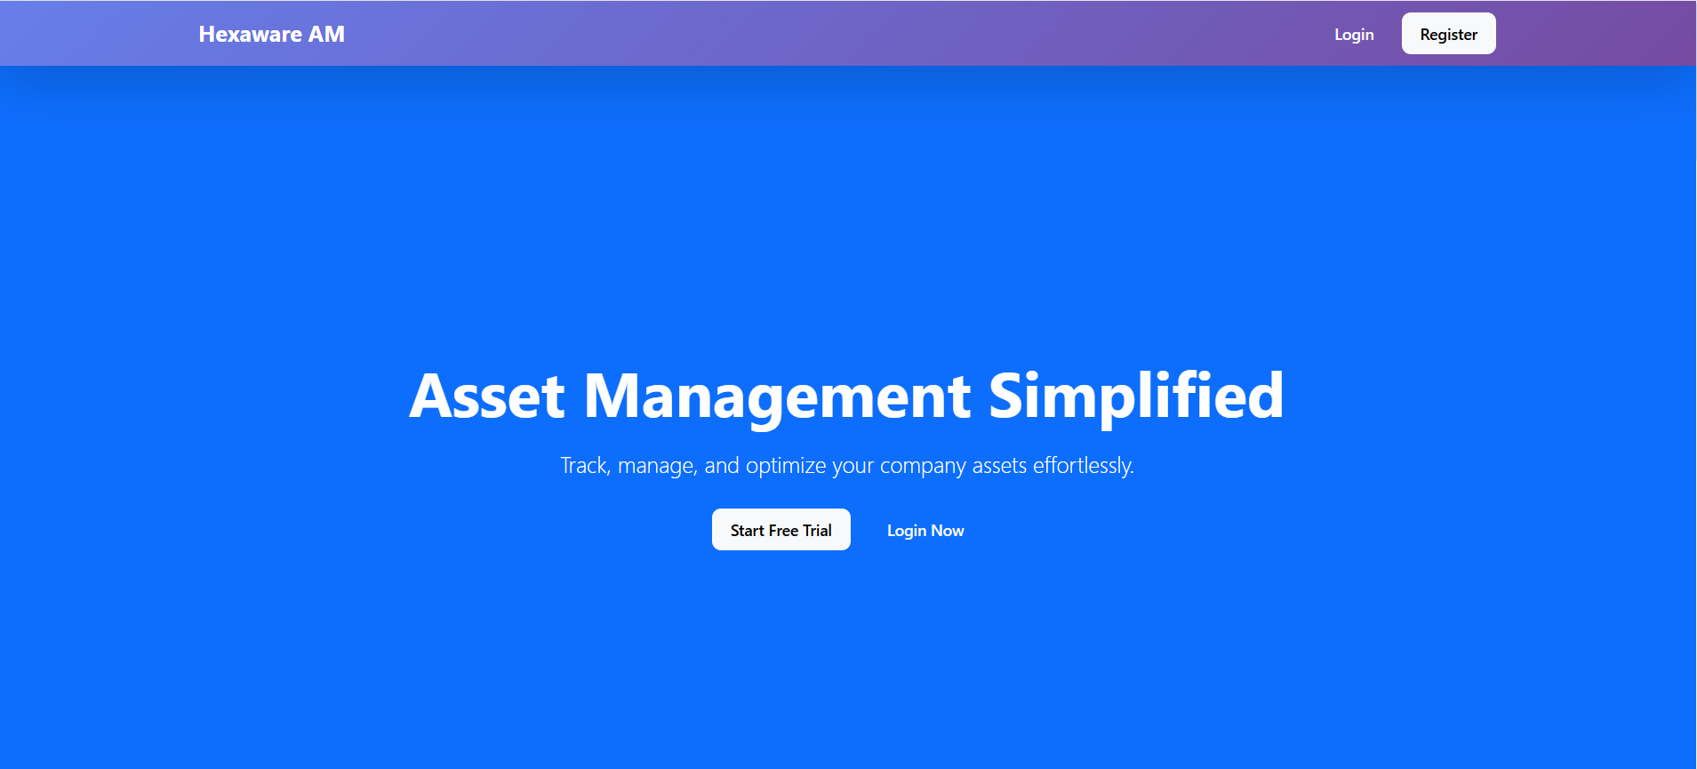
HOME PAGE

Slide 8
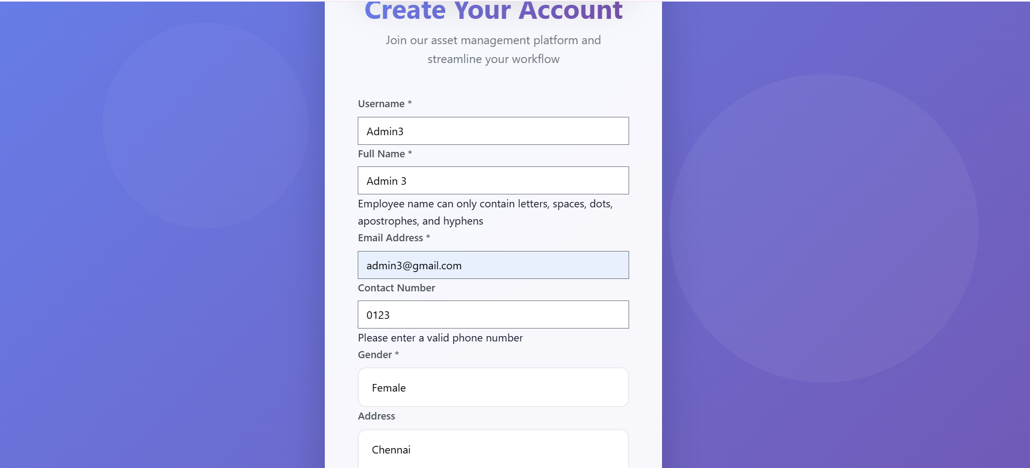
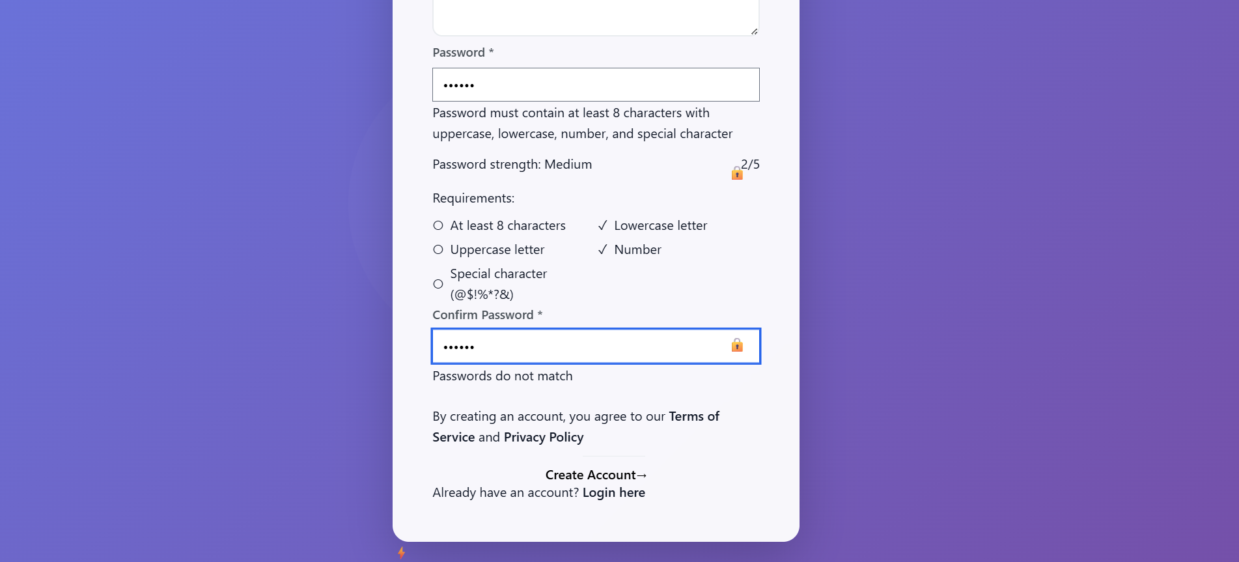
REGISTRATION PAGE
Registration Page along with Validations applied

Slide 9
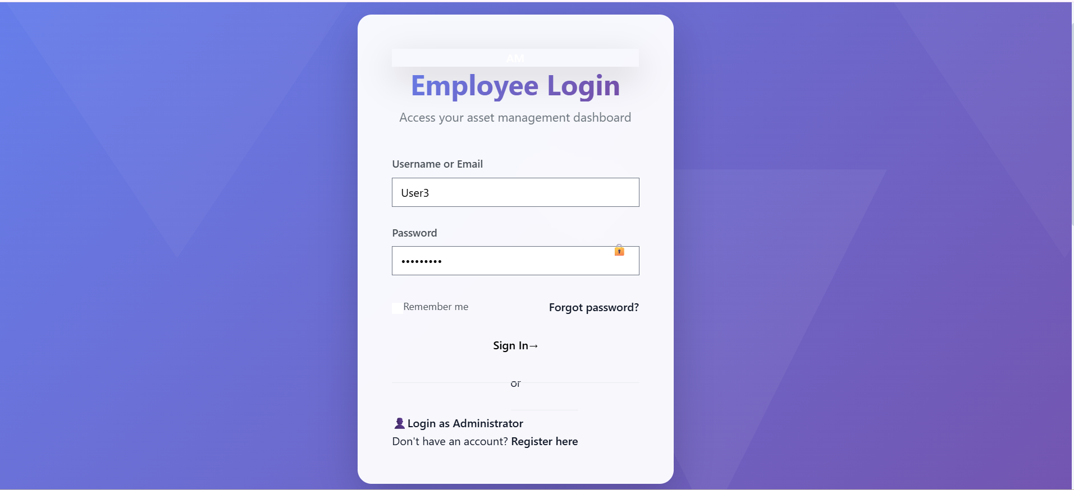
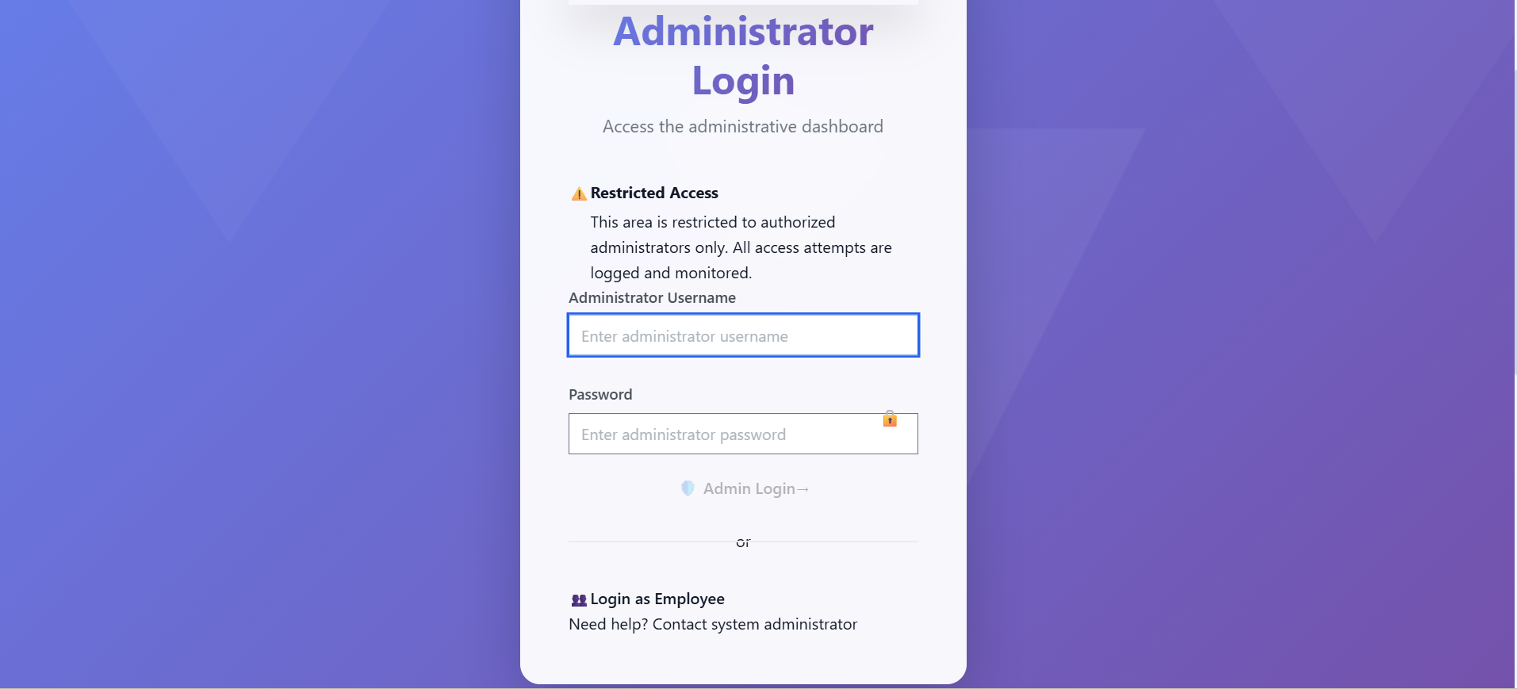
Login & Authentication
Secure JWT-based authentication with form validation, role-based access control, and professional user interface design with proper error handling.

Slide 10
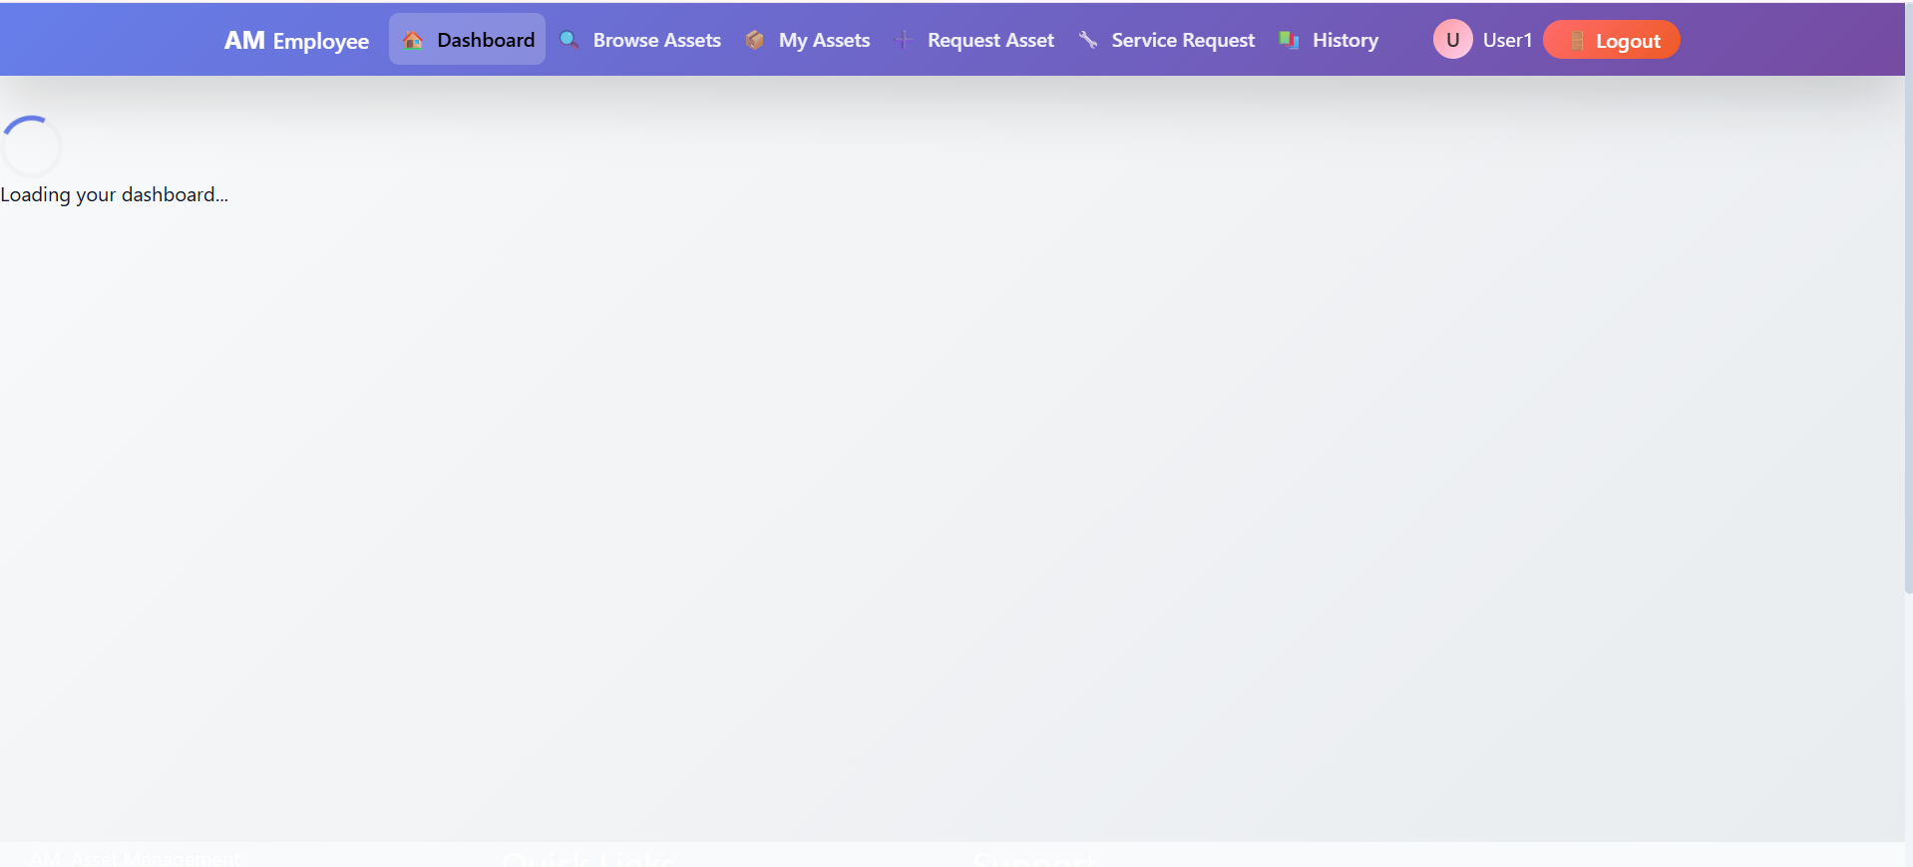
DASHBOARD
Comprehensive overview with asset statistics, pending requests, charts and analytics, quick actions, and real-time system status monitoring.

Slide 11
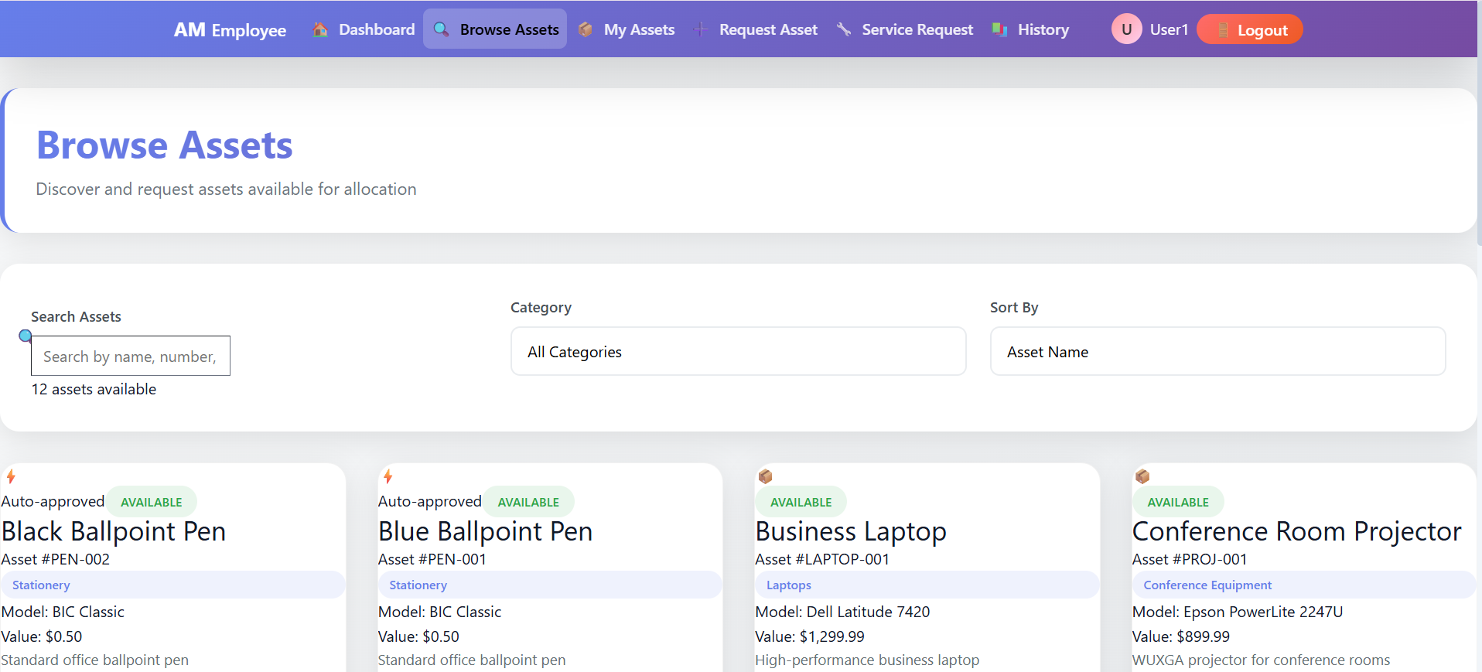
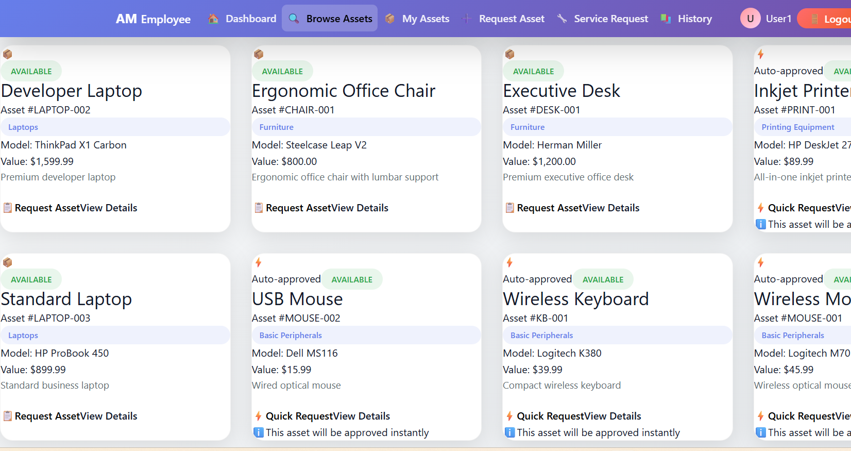
ASSET CATALOGUE
Complete asset listing with advanced search and filter options, detailed asset information, status indicators, and easy asset management tools.

Slide 12
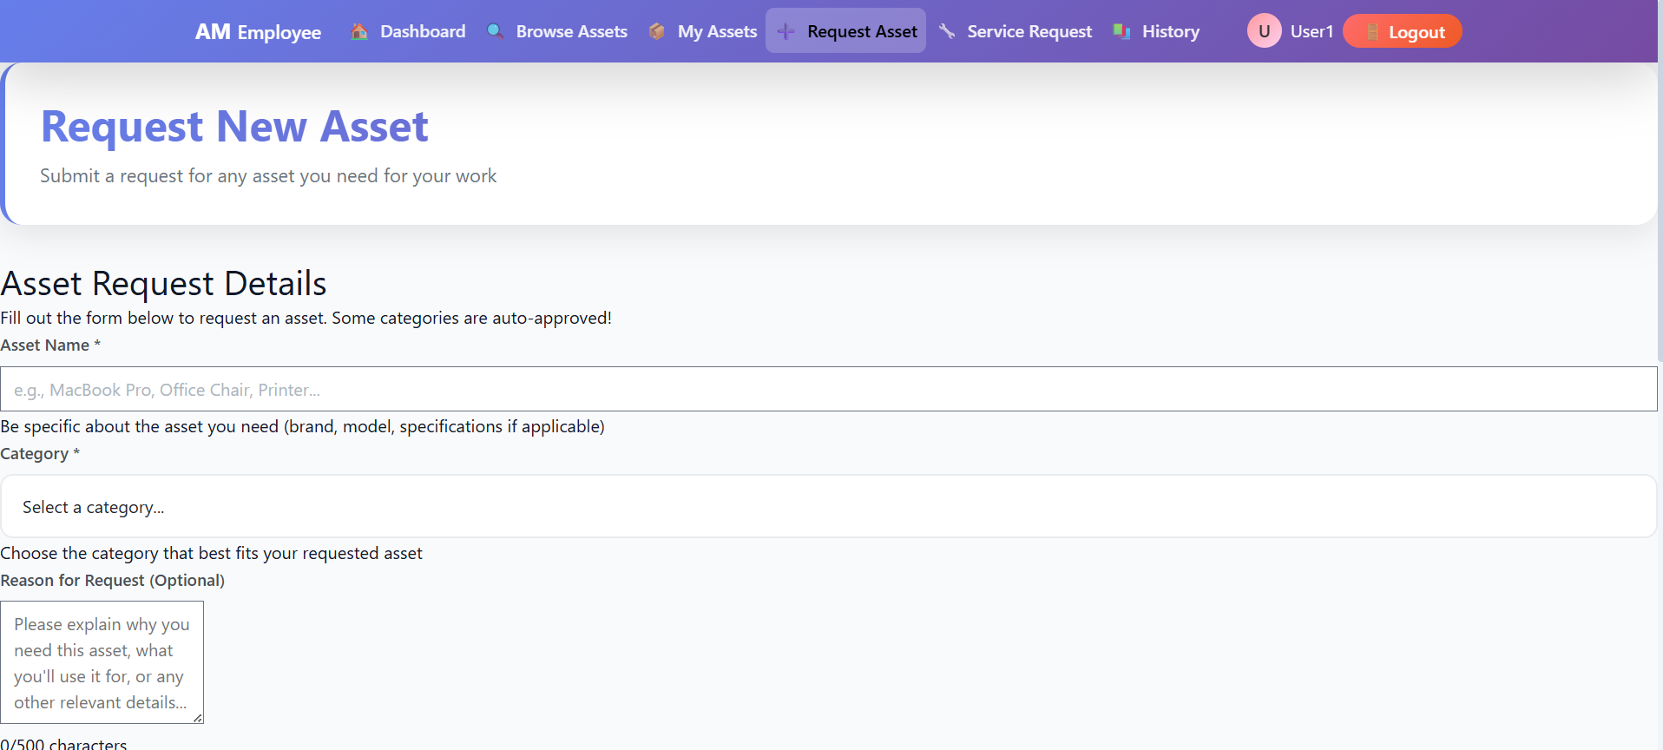
ASSET REQUEST
Employee asset request form with comprehensive validation, approval workflow, status tracking, and automated notification system.

Slide 13
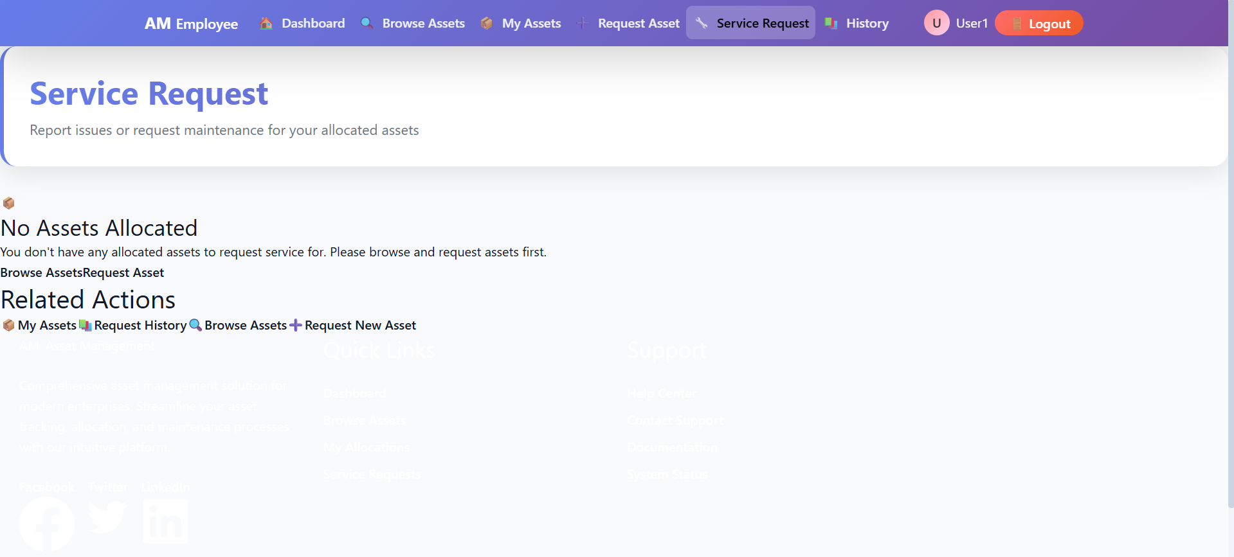
SERVICE REQUEST
Service request creation and management interface with status updates, priority settings, and administrative oversight capabilities.

Slide 14
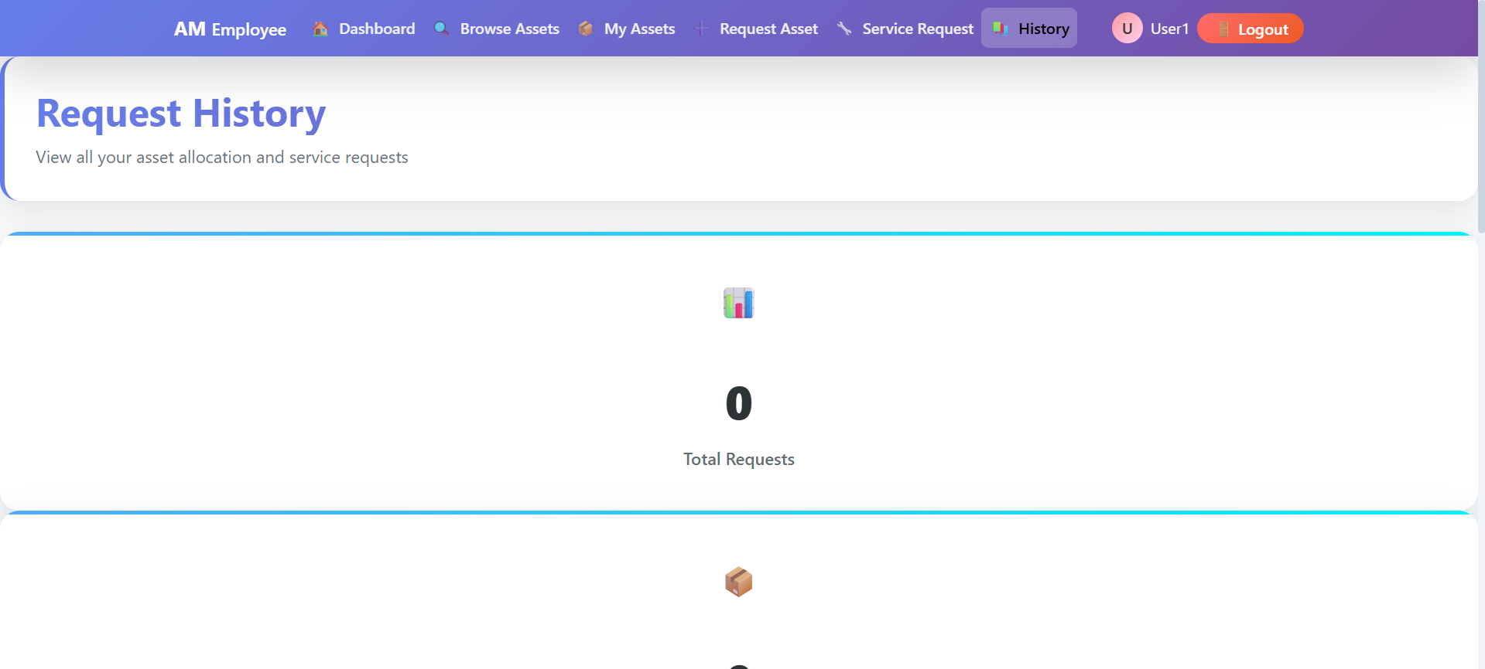
REQUEST HISTORY

Slide 15
THANK YOU!
Thank you for your attention and time in reviewing the Hexaware Asset Management System. This project represents a comprehensive solution to streamline asset tracking and management processes.

